Slide 1
Our Lady of Walsingham CMAT
St Louis Catholic Academy School, Newmarket
Thank you for your interest in leading the team at St Louis Catholic Academy School as Headteacher.
SR

Slide 2
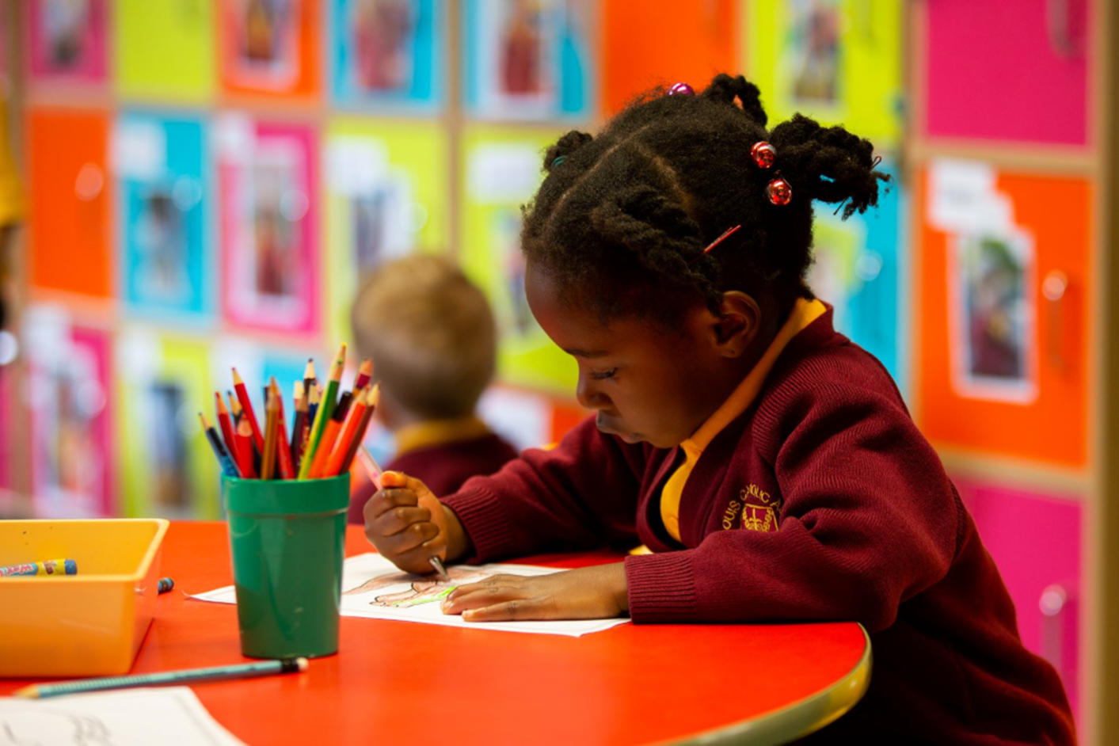
Our Thriving Catholic School
We are a thriving Catholic primary school situated near to the centre of Newmarket in Suffolk. Our Catholic Gospel Values are central to how we teach and learn together. We have strong bonds with our Our Lady Immaculate & St Etheldreda Parish and the wider community. Children learn independence and care for others from a young age and families work supportively alongside us.

Slide 3
Our School Community
Committed Governors: Our Governors work collaboratively to support our Headteacher, focusing on ongoing school improvement and delivering the best opportunities for all children
Strong Reputation: Visitors remark upon our pupils' excellent behaviour in our happy, secure, and stimulating environment
New Wellbeing Hub: Opening in Spring 2025, this purpose-built facility will enhance our already strong personal development offer
Extracurricular Activities: Children enjoy a great range of opportunities, including forest school, sport, choir, and cooking clubs
Dedicated Staff Team: Committed to improving opportunities and outcomes for learners, fully engaging in the wider life of the school
Staff Development: We invest in our staff with a commitment to lifelong learning
Active PTA: Hosts many events to build community and fundraise, supporting projects like our new outdoor gym and planned trim trail

Slide 4
Headship Opportunity at St Louis Catholic Academy
Exciting Transition
Supportive Environment
As our Headteacher retires, we are looking for a successor who relishes the challenge to continue and improve our wonderful school into the future; further build on Parish and community links and connect with Headteachers across our Trust schools.
We are fortunate to be part of a caring and supportive family of schools within Our Lady of Walsingham CMAT. You will have an established, strong peer network of other Trust Heads to work alongside as well as Central Trust colleagues. We are committed to your success and wellbeing.
Growth Opportunity
See us in action
Our next Headteacher will have the opportunity to lead a good school to reach its potential of outstanding. With our ongoing support you will reach your full potential as a leader, developing alongside the school and Trust in your career and expertise.
We are excited to meet you and as such would encourage you to visit the school and enjoy a tour with the current Headteacher and Deputy CEO. This will let you assess if you would want to take up this challenge, find out if it fits with your own values, and ensure you are better informed as to the role.

Slide 5
What being part of the Trust means to our staff...
“Our teachers and staff are well supported and there is a great sense of team both within individual schools and across the Trust. This sense of belonging and feeling valued is a great strength both in supporting wellbeing and for job satisfaction. Staff have greater opportunities for professional development and career progression within the Trust and this can include shared training sessions, access to external support and resources through shared acquisition, and pathways to leadership roles. To be succinct, being part of a Catholic Multi Academy Trust can lead to a richer educational experience through collaboration, shared resources, a unified ethos, and enhanced opportunities for both students and staff”
Head Teacher, St Pancras Primary School
'Being part of the OLOW MAT has been transformative for me. It has allowed me to grow and develop with the support and encouragement of colleagues and managers.'
Head Teacher, St Laurence Primary School
“Being part of Our Lady of Walsingham Catholic Trust offers numerous benefits that extend beyond academic excellence to encompass holistic development. Our trust fosters a strong sense of community and shared values rooted in Catholic teachings, which emphasize moral development, compassion, and social responsibility. Trust leaders promote the nurture of students not just intellectually but also spiritually and emotionally. The collaborative structure of our trust allows for the pooling of resources, expertise, and best practices across our schools, enhancing educational quality and opportunities for both students and staff. Additionally, the friendly and collegiate networks within our MAT drive continuous improvement through shared professional development, innovative teaching strategies, and cohesive leadership, ensuring a consistent, high-quality education grounded in our shared Catholic Ethos”
Head Teacher, St Alban's High School

Slide 6
“Being in the Trust provides a secure and supportive framework for my apostolic mission as a Catholic Headteacher”
Head Teacher, St Felix Primary School
“I am really enjoying my new role and am finding the Trust very warm, welcoming and supportive which is great”
Trust Lead SENDCo
“We have an open culture of collaboration. We learn from each other. In this Trust, you are never on your own. There's always someone to turn to for advice or guidance."
Deputy CEO & Trust Primary Improvement
"I really appreciate the supportive, collegiate and forward thinking nature of OLWCMAT. Just the right balance of challenge and support"
Head Teacher, St Mary's Primary School

Slide 7
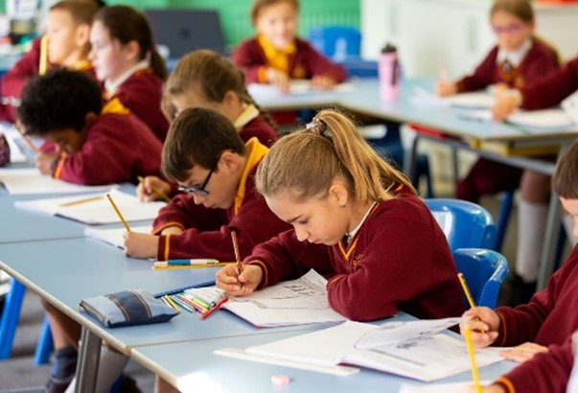
How to apply
To informally discuss this opportunity, please contact Clare Clark, Deputy CEO at cclark@olow.org.uk
0773022080
Arrange a Visit:
Further Information:
Complete & Submit Application Form
https://www.stlouisacademy.co.uk/job-vacancies
By 9th December 2024 (12 noon)
Shortlisting 10th December 2024
To arrange a visit to the school please contact:
01638 662719
admin@stlouisacademy.co.uk

Slide 8
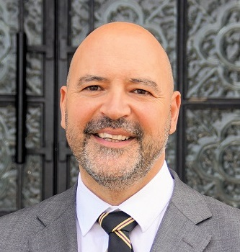
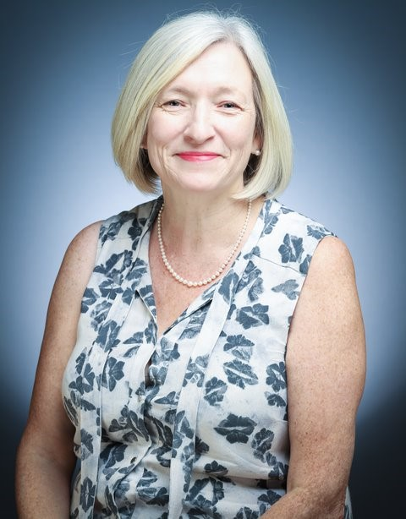
Our Lady of Walsingham Catholic Multi Academy Trust
Trust Commitment
Catholic Values
Growth and Collaboration
Our Trust is committed to delivering educational, spiritual and moral outcomes for all children regardless of their faith or background. We focus on:
The Trust is a Catholic-based, child-centred MAT. We are founded on Catholic values which underpin every social, academic and pastoral relationship and the related behaviours which act as live witness to our Faith. Supported by these values, we seek to develop the characteristics of effective learners in our children so that, whatever their future holds, they can approach this with character, confidence, resilience and a Christ-centred moral compass.
The number of schools within our Trust is steadily growing. By September 2025, we will be 9 Primaries and 2 secondary schools including 6th Forms under our stewardship. We pride ourselves upon collaboration and support for all our highly skilled committed headteachers. We are delighted that you are interested in joining our talented team.
Full inclusion
High expectations
Innovation
Outstanding teaching and learning
Relentless focus on every child's needs and potential
Our aim is for every school within the Trust to have a reputation for excellence in their local communities and beyond.
Yours faithfully,
Flavio Vettese Clare Clark
CEO Deputy CEO

Slide 9
What our children and families say about us:
In our Annual Parent Survey and SEND Parent Survey 2024, we were told:
Parent Survey Feedback
Our Governors met with our year 6 students in July 2024 to complete exit interviews
The children were asked to summarise their experience of school:
"The pupils are well behaved, happy and kind. There is a large range of extra curricular activities to choose from. Children are supported in their personal development."
"We have good experiences with the teachers. They really care and show an interest in my child's progress and development."
"Everyone is lovely, my daughter's teachers are amazing, working together for my daughter to have a perfect knowledge, education and faith."
"Great communication, good curriculum, caring teachers and staff. Thank you. As a Catholic School, the school supports my child to practice their faith."
"Tailored learning to child abilities. SendCo circuits are enjoyed. Teacher present at school end and will let you know snips of school day if she feels you should know."
“ School communication with parents, teachers are nice, I love the school”
SEND Survey Feedback
"Thank you for morning circuit and Calm club!!!"
"My child is more happy to do normal homework like other children at Y3. He did last homework with smile and without any questions. He's writing a sentence/ story everyday at home."
"Our child is very happy at St Louis and really likes his class environment, staff and pupils. He was supported well in feeling positive about moving into his new class which he had initially been very worried and tearful about. He likes attending Chatty Chefs."
"Since the instigation of coping strategies and circuits my child's ability to manage emotions and concentrate has improved."

Slide 10
Headteacher Job Description
The Our Lady of Walsingham CMAT and the School are committed to safeguarding and promoting the welfare of children and young people and requires all staff to share this commitment.
Post Title: Headteacher
Purpose: To plan, implement and deliver an appropriately broad, balanced, relevant and differentiated curriculum for students
Reporting to: Our Lady of Walsingham Catholic MAT Board of Directors, Local Governing Body, CEO, DCEO / Primary Improvement Lead
Liaising with: Executive Management Team, Head Teachers/Heads of School, Operational Group, teaching/support staff, LA, MAT and Diocesan representatives, Parish Priest(s) external agencies and parents
Salary/Grade: Leadership – L15 – L21 (£70,293 - £81,441)
Disclosure level: Enhanced
This appointment is with the Directors of the Trust under the terms of the OLWCMAT contract based upon the Catholic Education Service contract which is signed with the Trust as employers. The Directors and LGB will appoint a practising Catholic who can show by example and from experience that he or she will work to ensure that the school is Catholic in all its aspects. The appointment is subject to the current conditions of service for Headteachers contained in the School Teacher's Pay and Conditions document and other current education and employment legislation.
The Headteacher is accountable to the Directors and Local Governing Body for the professional leadership, strategic direction and operational management of the School in order to ensure that the school's aims are implemented in accordance with the school improvement plan and the policies of the Directors and Local Governing Body. The Headteacher is required to monitor, evaluate and review the impact of policies, priorities and targets of the school and take timely action as necessary.
Key Responsibilities:
Exercise the ministry of a teacher under the supervision of the Diocesan Bishop
Preserve and develop the Catholic character of the School
Take part in and lead acts of religious worship
Cooperate with the Diocesan Bishop and consult with appropriate stakeholders
Lead and participate in the selection and appointment of staff
Ensure daily collective worship in accordance with Catholic teachings
Implement pastoral care policies aligned with Catholic teachings
Liaise with the Diocesan Education Service
Work collaboratively with the OLWCMAT central team
Curriculum and Teaching:
Ensure outstanding teaching is the primary objective for all teachers
Implement a diverse, flexible curriculum for high-quality learning experiences
Ensure the curriculum provides for students' holistic wellbeing
Teach as necessary and appropriate relative to other duties
Community and Stakeholder Engagement:
Secure commitment from parents, carers, and the wider community
Act as an ambassador for the school, upholding its Catholic values and ethos
Seek opportunities to enhance the school's value in the local community
Contribute to the wider education system through partnerships and initiatives
Accountability and Governance:
Work with Directors and Local Governing Body on school development
Translate vision into a School Improvement Plan
Present accurate accounts of school performance to various stakeholders
Comply with school policies, including Health and Safety
This job description will be reviewed annually and may be amended after consultation with the postholder. The LGB will make reasonable adjustments to enable access to employment opportunities for disabled applicants or continued employment for any employee who develops a disabling condition.

Slide 11
To provide for liaison and cooperation with officers of the Diocesan Education Service, making such reports to the Diocesan Education Service and the Directors and Trustees in connection with the discharge of your functions as they may properly require, either on a regular basis or from time to time.
2 LEADERSHIP AND MANAGEMENT OF STUDENT/PUPIL ACHIEVEMENT, SPIRITUAL GROWTH, PROGRESS AND SAFETY
Ensure that student safety is at the centre of all of the School’s functions, in particular strategic planning and resource management.
Ensure an aspirational culture and ethos of challenge and support where all students/pupils can achieve success and become engaged in their own learning and the learning of others.
Ensure a consistent and continuous school-wide focus on students/pupils’ achievement, using data and benchmarks to monitor progress in every pupil’s learning.
Implement strategies which secure high standards of behaviour and attendance, student welfare, and citizenship.
Ensure collaboration with other agencies in providing for the intellectual, spiritual, moral, cultural, physical, social and emotional wellbeing of students/pupils
3 LEADING AND MANAGING STAFF
Ensure that outstanding teaching is the primary objective for all teachers.
Lead, motivate, support, challenge and develop staff to secure improvement.
Ensure that all staff are engaged with the school’s key improvement priorities and the development of the school’s aims and objectives, through effective communication across the whole school community, whether they be teaching or support staff.
Maximise the contribution of staff to improve the quality of education provided and standards achieved.
Implement and sustain rigorous procedures for monitoring the performance of all staff including objective setting and personal development plans.
Acknowledge the responsibilities and celebrate the achievement of individuals and teams.
4 LEADERSHIP AND MANAGEMENT OF CURRICULUM
Determine and ensure implementation of a diverse, flexible curriculum to ensure high quality and personalised learning experiences for students/pupils of all backgrounds and abilities.
Develop and champion the impact of the school’s curriculum on student opportunity and outcomes.
Ensure that the curriculum is providing for the intellectual, spiritual, moral, cultural, physical, social and emotional wellbeing of all students/pupils
Ensure that the curriculum enables students/pupils to progress successfully to the next stage of education on exit from the school.

Slide 12
5 MANAGING RESOURCES
Promote creativity, innovation and the use of appropriate existing and new technologies to achieve excellence.
Work in collaboration with the central team of OLWCMAT.
Agree and set appropriate priorities for expenditure with the Directors and Local Governing Body; allocate funds and monitor the effective administration and control of school budgets so that the School secures its objectives.
Deploy and manage the school’s financial and human resources efficiently and effectively to achieve the school’s educational goals and priorities in line with the school’s strategic plan and financial context.
Ensure school buildings and facilities meet the needs of the students/pupils and staff and are of the highest standard of cleanliness and repair and compliant with health and safety regulations.
Explore and develop additional sources of funding.
6 STAKEHOLDERS AND THE LOCAL COMMUNITY
Secure the commitment of all parents and carers, especially hard-to-reach parents, and the wider community, particularly the Parish and clergy to the vision and direction of the school.
Act at all times as an ambassador for the school in a manner which upholds its Catholic values and ethos.
Seek opportunities to communicate and enhance the value of the school to other sectors of the local community.
Contribute to the development of the education system by sharing effective practice, working in partnership with other schools, especially other primary schools and secondary schools which the school feeds, and promoting innovative initiatives.
7 ACCOUNTABILITY AND GOVERNANCE
Work with the Directors and Local Governing Body to analyse and plan for the future needs and further development of the school within the local, national and international context.
Translate the vision into a School Improvement Plan with agreed, prioritised, objectives and operational plans which will promote and sustain school improvement within an agreed timeframe.
Encourage a school ethos which enables everyone to work together, share knowledge and understanding, celebrate success and accept responsibility for outcomes.
Present a coherent and accurate account of the school’s performance in a form appropriate to a range of audiences, including parents, the local authority, the local community, Ofsted, the Trust and others, to enable them to contribute effectively.

Slide 13
8 TEACHING
• Teach as necessary and appropriate relative to the other duties of the post.
9 OTHER SPECIFIC DUTIES
To play a full part in the life of the school community to lead its distinctive mission and ethos and to encourage staff and students to follow this example.
To lead the school in meeting its legal requirements for worship.
To promote actively the school and Trust’s corporate policies.
To continue personal development as agreed.
To lead the implementation and comply with the school’s Health and Safety policy and undertake risk assessment as appropriate.
To undertake any other duty as specified by STPCD not mentioned in the above.
Whilst every effort has been made to explain the main duties and responsibilities of the post, each individual task undertaken may not be identified.
The Headteacher may be asked by the Governing Body to undertake other duties reasonably regarded as falling within the duties and responsibilities of the post. This job description will be reviewed annually at the end of the academic year or earlier if necessary. In addition, it may be amended at any time after consultation with the postholder. Employees of the Trust are expected to be courteous to colleagues and provide a welcoming environment to visitors and telephone callers.
The LGB will endeavour to make any necessary reasonable adjustments to the job and the working environment to enable access to employment opportunities for disabled job applicants or continued employment for any employee who develops a disabling condition.
This job description is current at the date shown, but following consultation with you, may be changed by the Directors to reflect or anticipate changes in the job which are commensurate with the salary and job title.

Slide 14
Person and Knowledge Specification
Criteria
Essential
Desirable
Experience
A practicing Catholic
✓
Secure understanding of the distinct nature of the Catholic school
and Catholic education
✓
Understanding of a Leadership role and spiritual development
Of pupils and staff
✓
Experience in leading acts of worship in a Catholic school
✓
Ability to articulate & share a vision of primary education within
the context of the mission of the school
✓
Ability to inspire & motivate staff, pupils, parents and governors
To achieve the aims of Catholic education
✓
Evidence of successful strategies for planning, implementing,
Monitoring & evaluating school improvement
✓
Ability to analyse data, develop strategic plans, set targets
And monitor / evaluate progress of these
✓
Knowledge of what constitutes quality in education provision, the characteristics of effective
schools & strategies for raising standards
✓
Understanding of & commit to promoting and safeguarding
The welfare of pupils
✓
Knowledge of the role of governing body in a Catholic school
✓
Evidence of having successfully translated vision into reality at a whole school level
✓
Ability to delegate work & support colleagues in undertaking responsibilities
✓

Slide 15
Person and Knowledge Specification
Criteria
Essential
Desirable
Experience
Understanding of effective budget planning & resource deployment
✓
Experience of performance management and supporting the continuing professional
Development of colleagues
✓
Experiencing of working with Governors to enable them to fulfill whole school responsibilities
✓
Successful involvement in staff recruitment / appointment / induction
✓
Understanding of how financial & resource management enable a school to
Achieve its educational priorities
✓
Principles and practice of effective strategies for learning & assessment
✓
Ability to demonstrate accuracy
✓
Organisational skills
✓
Working knowledge & skills of ICT
✓
Good communication skills with people of all levels
✓
Ability to gain respect from pupils through manner of confidence & authority
✓
Financial understanding and / or management of budgets
✓
Ability to analyse data
✓

Slide 16
Person and Knowledge Specification
Criteria
Essential
Desirable
Experience
A secure understanding of the requirements of the National Curriculum & wider
Curricular opportunities
✓
Knowledge & experience of a range of successful teaching and learning strategies to meet
The needs of pupils
✓
A secure understanding of assessment strategies and the use of assessment to form the
Next stages of learning
✓
Experience of effective monitoring & the evaluation of teaching & leaning
✓
Secure knowledge of statutory requirements relating to the curriculum & assessment
✓
Understanding of the characteristics of an effective learning environment & the key elements to
Successful behaviour management
✓
Successful experience in creating an effective learning environment and in developing &
Implementing policy and practice relating to behavior management
✓
Able to work calmly under pressure
✓
Ability to critically evaluate own performance & make changes to be more effective
✓
Commitment to the Catholic ethos of the school
✓
Enthusiastic, honest & reliable
✓
A passion for child centre leaning
✓
Ability to share a dynamic vision for the implementation of programmes & projects
✓

Slide 17
Person and Knowledge Specification
Criteria
Essential
Desirable
Experience
A sense of purpose & the ability to take personal initiative
✓
A sensitive, flexible & open minded & responsive approach when working with others
✓
Ability to work effectively as part of a team and to have a collegiate attitude
✓
High quality teaching skills
✓
High expectations of pupils learning & attainment
✓
Strong commitment to school improvement & raising achievement for all
✓
Ability to build & maintain good relationships
✓
Ability to remain positive and enthusiastic when working under pressure
✓
Empathy with children
✓
Stamina & resilience
✓
Positive recommendation in professional references
✓
Satisfactory Health & Attendance Records
✓
Professional reference without reservation
✓

Slide 18
Person Specification and Qualifications
Criteria
Essential
Desirable
Experience
Leadership responsibility within a team
✓
Successful teaching experience and experience of leading within a subject area / Key stage
✓
Successful teaching experience and experience of leading within more than one subject area / Key stage
✓
Recent experience in a Catholic school or Academy
✓
Experience as Head of School / Deputy / Assistant Headteacher or a member of SMT
✓
Experience of teaching in more than one school
✓
Qualifications and Training
Degree or equivalent
✓
QTS
✓
Evidence of continuing professional development
✓
Postgraduate level qualification
✓
NPQH award or Leadership Pathways certification
✓
CCRS or equivalent
✓

Slide 19
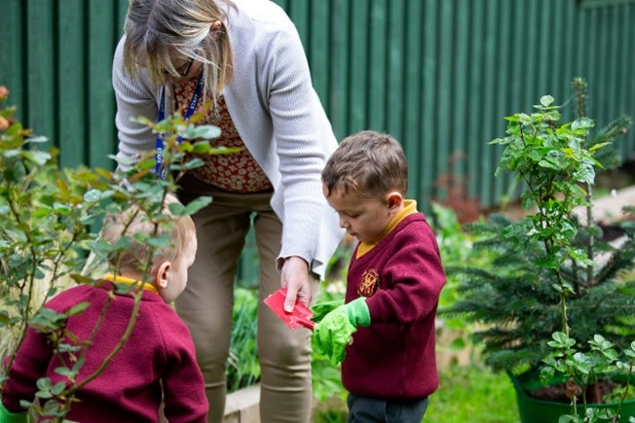
Safeguarding Commitment
This Local Governing Body and Directors are committed to safeguarding and promoting the welfare of children and young persons and Headteachers must ensure that the highest priority is given to following the guidance and regulations to safeguard children and young people. The successful candidate will be required to undergo an Enhanced Disclosure from the Disclosure and Barring Service (DBS) and complete a Disqualification Declaration.

